Slide 1

IOS workshop
Martin Iliev

Slide 2

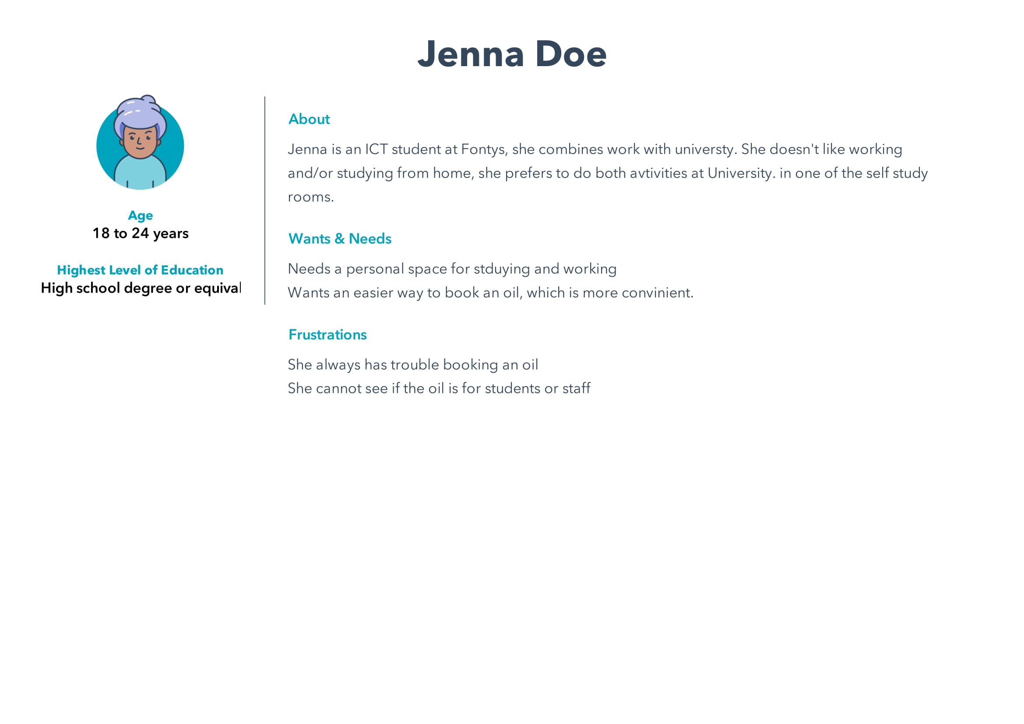
Title:
Persona
The persona is limited, due to the request of the user to keep their identity more private

Slide 3

The Idea
The idea behind the app is to help the students being able to reserve oils in an easier manner and see the location and information of the universities. The app is liner and simple. Which makes it easier for the student to navigate through

Slide 4
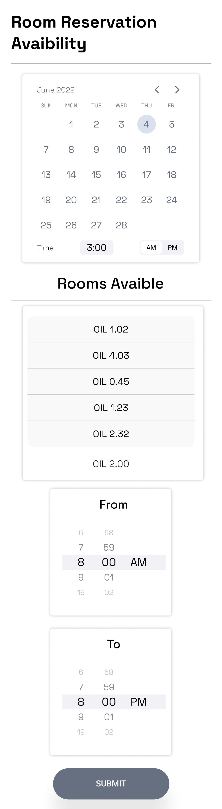

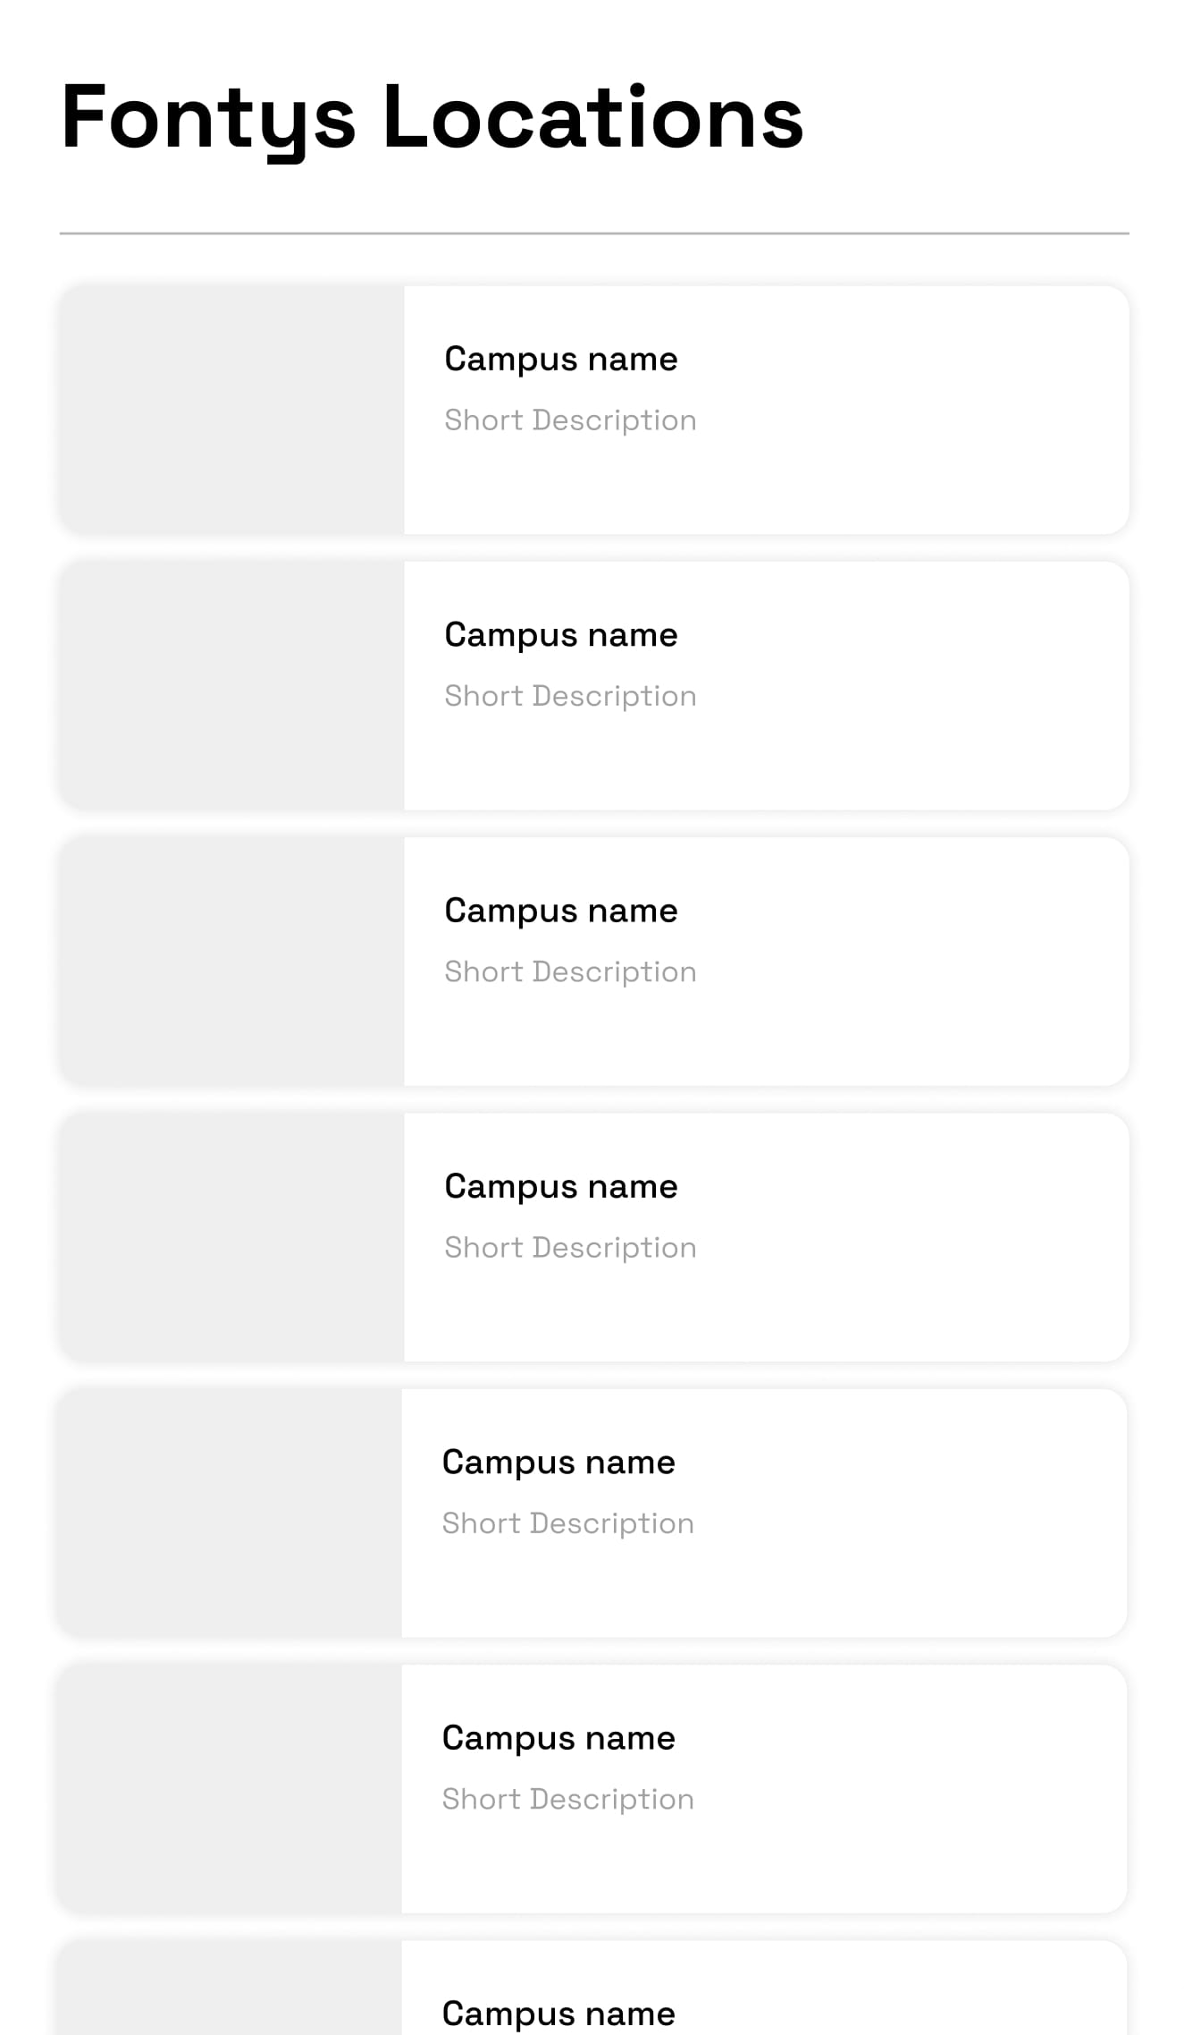
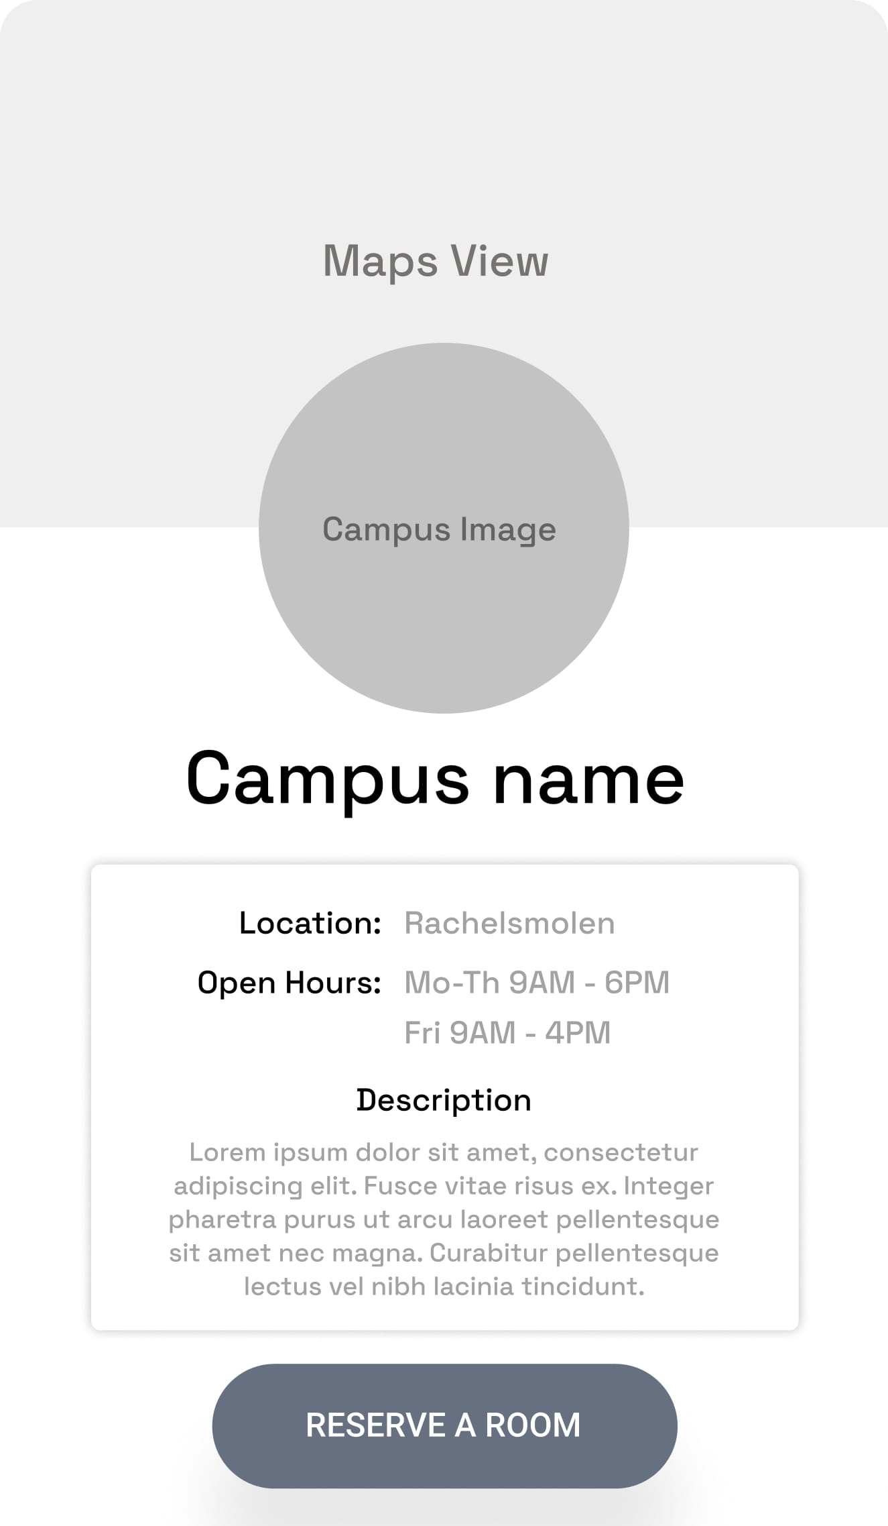

Slide 5
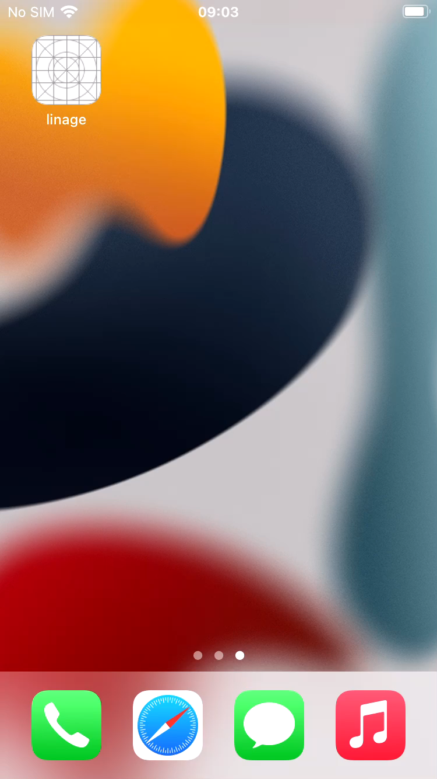

Slide 6

Learning outcome
SUBTITLE GOES HERE
Even tough the app didn’t have the reservation part. There was a quite a journey in the learning process, like:
The Navigation system
Dynamic Content Loading
The Map extension
Frame manipulation for images and

